Slide 1

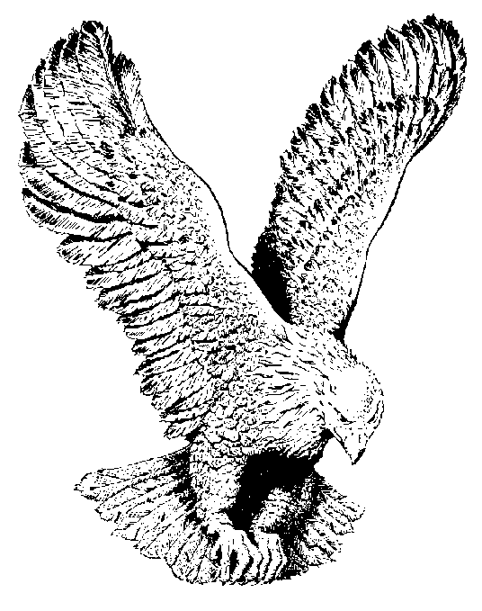
ALLELUIA! ALLELUIA! ALLELULIA!
Alleluia! Alleluia! Alleluia!
The strife is o’er, the battle done;
The victory of life is won;
The song of triumph has begun,
Alleluia!

Slide 2
The powers of death have done their worst
But Christ their legions hath dispersed;
Let shout of holy joy outburst.
Alleluia!

Slide 3
The three sad days have quickly speed,
He rises glorious from the dead,
All glory to our risen Head.
Alleluia!

Slide 4
He breaks the age bound chains of hell;
The bars from heaven’s high portals fell,
Let hymns of praise His triumph tell;
Alleluia!

Slide 5
Lord, by the stripes which wounded Thee,
From death’s dread sting Thy servants free,
That we may live, and sing to Thee,
Alleluia!

